Slide 1
Kaiser Permanente
Improve patient satisfaction and wellbeing
Product Owner: Nélio Macombo
© 2019 Udacity. All rights reserved.

Slide 2
Background
Why are We Here?
This project aims to develop a solution for Kaiser Permanente that helps patients increase physical activity, improve eating healthier food and prevent themselves from the top five death-causing illnesses in the United States.
© 2019 Udacity. All rights reserved.

Slide 3
Business Case
© 2019 Udacity. All rights reserved.
Notes:
[ALL PARTICIPATION]

Slide 4
Initial Focus
Where are we starting?
This Focus was chosen to matches the following company goals:
Improve patient satisfaction and wellbeing;
Reduce the cost by emphasizing improvements on health habits prior to any adverse conditions developed by the body;
© 2019 Udacity. All rights reserved.

Slide 5
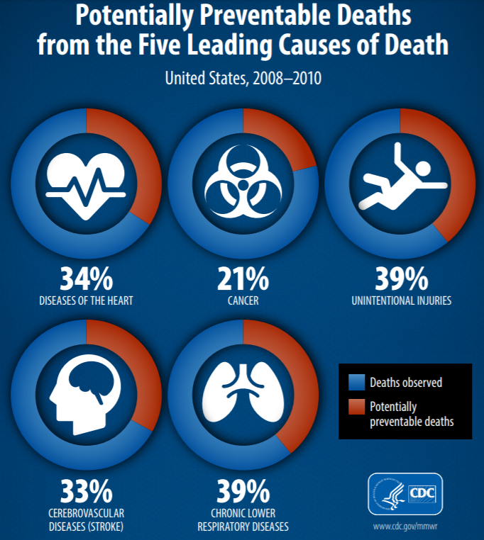
Opportunity
What’s the problem?
Each year, nearly 900,000 Americans die prematurely from the five leading causes of death – yet 20 percent to 40 percent of the deaths from each cause could be prevented by making changes in personal behaviors, according to a study from the Centers for Disease Control and Prevention;
The five leading causes of death in the United States are heart disease, cancer, chronic lower respiratory diseases, stroke, and unintentional injuries;
In 2018, the global wellness industry market accounted for $4.2 trillion with $595 billion in spending for fitness and mind-body products (Global Wellness Institute Survey, 2018)
Over 75% of active users open their fitness apps at least two times a week.
As well, 25% of the most engaged users open health or fitness apps more than 10 times a week (Flurry Analytics Survey, 2017).
© 2019 Udacity. All rights reserved.

Slide 6
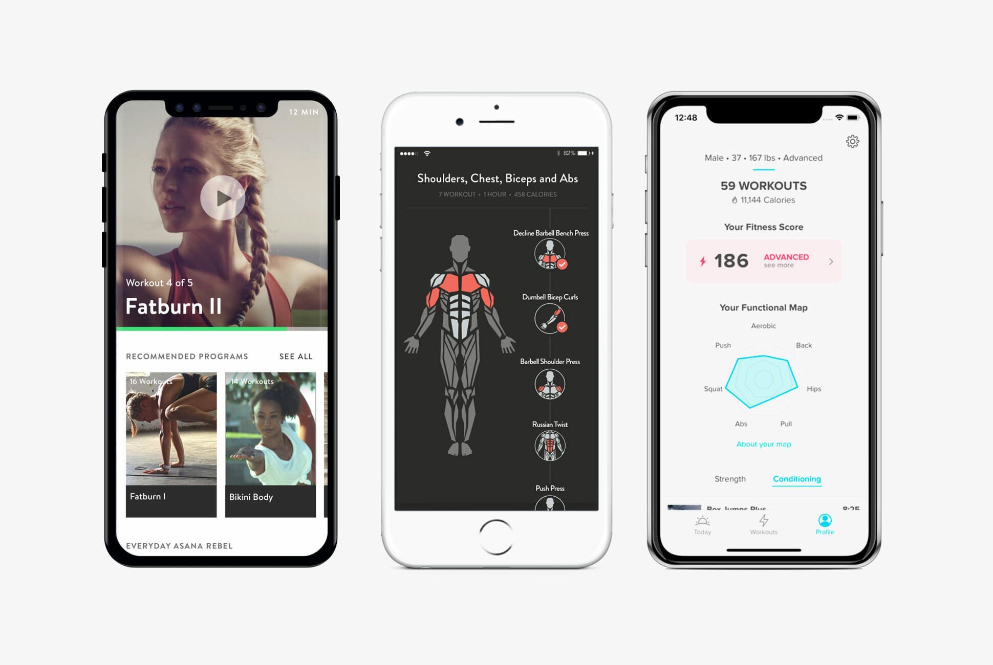
Proposal
What’s Our Solution?
APP
Investment: Medium
Ease of Use: Little Friction
Market: Large
mobile application that helps users perform exercises, healthier diet and monitors and advise with tips about their health habits;
© 2019 Udacity. All rights reserved.

Slide 7
Return On Investment
Opportunity in numbers - TAM
This Focus was chosen to matches the following company goals:
330 million people lives in the US;
On Average 8 million people use Fitness & Health Tracker Apps in US on monthly basis (MAU – Monthly Active Users) according to Statista;
On Average people spend $10 on Fitness & Health Tracker Apps in USA on monthly basis (represents our revenue per user) according to My Protein;
TAM = (8 million MAU of Fitness & Heath Tracker Apps) X ($10 per month) = $80.000.000 TAM
© 2019 Udacity. All rights reserved.

Slide 8
Return On Investment
Opportunity in numbers – Development Cost, Timeline & ROI
Stage | Cost | Timeline
Design, Development, Test & Launch | $50.000 - $80.000 | 03 - 05 months
Members KP | Price ($) | Estimated Revenue | Cost | ROI
12,000,000 | 9.99 | 119,880,000 | 80,000 | 149750%
© 2019 Udacity. All rights reserved.

Slide 9

Measurement
How will we know if we’re successful?
Profit Growth (MOM and YOY);
Revenue Generated (MOM and YOY);
Subscriber Base (YOY);
Churn Rate (MOM and YOY);
Customer Satisfaction (NPS Score, Ratings);
Key Metrics for our Success
Legend:
MOM – Month on Month
YOY – Year on Year
© 2019 Udacity. All rights reserved.

Slide 10
Measurement
How will we know if we’re successful?
Profit Growth (MOM – 3% and YOY – 15%);
Revenue Generated (MOM – $100 Million and YOY - $1200 Million);
Subscriber Base (YOY - 50 Millions users);
Decrease Churn Rate (MOM – 10%);
Customer Satisfaction (NPS Score – 9 points, Ratings 04 stars);
Goals for 01st Year
© 2019 Udacity. All rights reserved.

Slide 11
Competitors
© 2019 Udacity. All rights reserved.
Notes:
[ALL PARTICIPATION]

Slide 12
Competitors
 | FREELETICS | STRAVA | MYFITNESSPAL
Product Offering | Free Apps with Subscription (In App Purchase) | Free Apps with add-on subscription | Free App with Subscription
Category | Workout and exercise apps | Activity tracking apps | Nutrition Apps
Key Features | Custom Training Journeys, Digital AI coaching, Nutrition guidance, | Running & Cycling tracking | Nutrition & Activity tracking
Differentiators | AI Coaching Assistant | Social sharing | Food database
Target Customers | Athletes Fitness Enthusiasts Workouts Enthusiasts | Runners Cyclists Fitness Enthusiasts | Tracking and managing diet
Distribution Channels | App Store, Play Store | Apple Store, PlayStore | App Store
Market Penetration | 31 Million Users | 42 Million Users | 225 Million Users
Price | $34.99 / 03 Month Subscription | $2 – 6 / months | $10/month
Revenue | $10 Millions | $1 Million | $03 Millions
© 2019 Udacity. All rights reserved.

Slide 13
Our Advantages
Why are we better?
Users will improve and track their fitness (throw personalized exercise plan and AI personalized assistant) and also improve their eating habits;
Our App will connect users to fitness trainers and nutritionist for personalized plan;
Our App will allow users to share progress with friends;
Our App will organize and allow users to access the health data via App and USSD/SMS;
Our App will Connect health users data from application with Health and Insurance Plan in order to maintain health data integrated and accessible;
© 2019 Udacity. All rights reserved.

Slide 14
Roadmap and Vision
© 2019 Udacity. All rights reserved.
Notes:
[ALL PARTICIPATION]

Slide 15
Roadmap Pillars
Our vision
We will organize users health data and empower users to adopting fitness, eating habits and preventing them for any disease;
Main Themes:
Manage Fitness Goals;
Manage Health Habits;
Reporting, Notification & Sharing;
© 2019 Udacity. All rights reserved.

Slide 16
Manage Fitness Goals
Set Up Goal of exercise/eating habit on day / week;
Support for multiple exercise;
Exercise Management - edit and delete existing goals (exercise or diet routine);
Exercise prompt notification at designated time for practice;
Exercise feedback of achievement in terms of points after exercise in performed;
© 2019 Udacity. All rights reserved.

Slide 17
Manage Health Goals
Set-Up Goal for healthier eating habit on day;
Suggestions of menu and meals on weekly basis;
Edit and delete existing goals;
Prompt notifications for eating;
Connect health data with medical process and insurance plan;
© 2019 Udacity. All rights reserved.

Slide 18
Reporting, Notification and Sharing
Weekly reports basis on the Goal;
Personalized Summary based on Goals (exercise routine and diet habits);
Connect and Share summary with close Friends, doctors and nutritionists;
© 2019 Udacity. All rights reserved.

Slide 19
Where do we go from here.
Widening the scope
Organize worlds user health data, empower humans to adopting fitness and eating habits preventing them for any disease;
© 2019 Udacity. All rights reserved.

